Slide 1

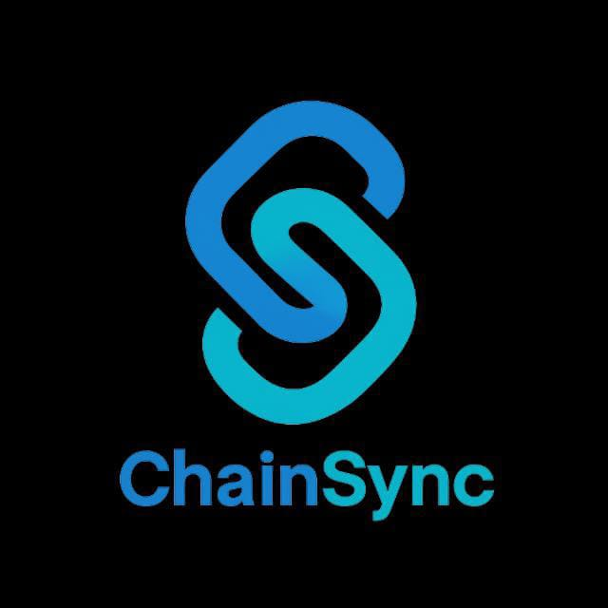
ChainSync
AI-Powered Logistics Intelligence Platform
Reducing India's ₹8 Lakh Crore logistics inefficiency through intelligent route optimization, load planning & real-time decision automation
$317B
14%
6%+
India Logistics Market 2024
Logistics Cost as % of GDP
Above Global Benchmark
Business Symposium 2025

Slide 2

CS
Lean Canvas
ChainSync
PROBLEM
SOLUTION
UNIQUE VALUE PROP
UNFAIR ADVANTAGE
CUSTOMERS
14% of GDP on logistics vs 8% globally
70% road freight with zero optimization
3.5 day port turnaround vs 6 hours
80% SME fleets lack tech
AI Route Optimizer
Smart Load Planner
Decision Automation
Fleet Analytics
RAG AI Assistant
India-first AI logistics for SME fleets
India road/traffic data
Vernacular NLP models
Offline-first mobile
Transport associations
PRIMARY:
Vernacular language support
Works on 2G networks
₹500/vehicle/month
3PLs (20-100 trucks)
Manufacturing
FMCG distributors
₹8L Cr inefficiency
SECONDARY:
E-commerce
Cold chain
15-25% cost cut
TAM: $6-7B
KEY METRICS
CHANNELS
Cost per km reduction
On-time delivery rate
Fleet utilization %
MRR and Churn
Direct B2B sales
Transport associations
OEM partnerships
Digital marketing
COST STRUCTURE
REVENUE STREAMS
35% Sales/Mktg
25% Cloud
CAC: ₹15K | LTV: ₹90K
SaaS
Enterprise
Value-share
Break-even: 18-24mo
30% Engineering
10% Ops
₹500-2K/vehicle/mo
₹5-15L/year
0.5% of savings
Y3 ARR: ₹12 Cr

Slide 3

CS
Business Model Canvas
ChainSync
KEY PARTNERS
KEY ACTIVITIES
VALUE PROPOSITIONS
CUSTOMER SEGMENTS
STRATEGIC:
AI/ML model development
Route optimization R&D
Mobile app (low-bandwidth)
Customer onboarding
24/7 support
Cut logistics costs 15-25% for Indian fleet operators
TIER 1:
Tata Motors, Ashok Leyland
AIMTC - Transport Congress
BSNL/Jio - Data bundles
FOR FLEET OWNERS:
3PL Providers (20-100 trucks)
Revenue: ₹10-100 Cr/year
15-25% fuel cost reduction
30% faster route planning
Real-time traffic rerouting
TIER 2:
TECH:
Manufacturing logistics
FMCG distribution
Google Maps / MapMyIndia
AWS / Azure cloud
FOR DRIVERS:
Vernacular voice navigation
Simple mobile interface
TIER 3:
CHANNEL:
E-commerce, Cold chain
Fuel stations, Toll plazas
Transport finance NBFCs
FOR ENTERPRISES:
TAM: $317B
Complete fleet visibility
Predictive maintenance
SAM: $6-7B
CUSTOMER RELATIONS
Self-service - App + dashboard
Dedicated - Enterprise accounts
Community - Fleet network
Training - Onboarding
KEY RESOURCES
CHANNELS
Tech: AI/ML models, algorithms
Data: India road/traffic datasets
Team: AI engineers, logistics experts
IP: Proprietary optimization engine
Direct: B2B sales (enterprise)
Partners: OEMs, associations
Digital: Website, LinkedIn
Events: Transport expos
COST STRUCTURE
REVENUE STREAMS
FIXED (60%)
VARIABLE (40%)
Y1 Burn: ₹1.5 Cr
SUBSCRIPTION (70%)
LICENSING (20%)
VALUE-SHARE (10%)
Y1: ₹60L
Engineering: ₹80L/yr
Sales: 10% rev | Marketing: ₹30L/yr
Gross Margin: 70%+
Starter: ₹500/vehicle/mo
₹5-15 Lakh/year
0.5% of savings
Y3: ₹12 Cr
Cloud: ₹40L/yr | Ops: ₹20L/yr
Pro: ₹1,200/vehicle/mo
100+ vehicle fleets

Slide 4
Financial Roadmap
CS ChainSync
5-YEAR PROJECTION (Rs. Lakhs)
UNIT ECONOMICS
Metric
Y1
Y2
Y3
Y4
Y5
CAC
ARPU/Year
Revenue
79
245
503
835
1,225
Rs.12,000
Rs.73,000
LTV (3yr)
LTV:CAC
Customers
128
368
712
1,133
1,598
Rs.1,86,000
8.5:1
Vehicles
1,250
3,984
8,233
13,848
20,544
Payback
Gross Margin
2 months
72%
5-YR REVENUE
BREAKEVEN
5-YR ROI
INVESTMENT REQUIRED
Rs.29.5 Cr
Month 24-30
1,181%
Initial Development
Runway to Breakeven
Rs.1.2 Crores
Rs.2.1 Crores
PRICING TIERS (Per Vehicle/Month)
WHY WE WIN
Starter 1-5
Pro 6-20
Ent 21-50
Ent+ 51+
50-75% cheaper than competition
Rs.749
Rs.599
Rs.449
Rs.349
India-first: Vernacular + 2G support
Self-serve model = 10x lower CAC
Source: Industry benchmarks (Mordor Intelligence, OpenView SaaS metrics), competitor pricing from public sources

Slide 5
Customer Acquisition Strategy
CS ChainSync
HOW WE ACQUIRE CUSTOMERS
WHY THEY CHOOSE US OVER COMPETITION
1
Digital-First Self-Serve (60%)
PRICE: 50-75% Lower Than Competition
SEO for 'fleet management software India', Google/Meta ads, WhatsApp Business onboarding. CAC: Rs.8,000
Locus/FarEye
vs
ChainSync
Rs.1,500-3,000
Rs.349-749
2
Transport Association Partnerships (25%)
INDIA-FIRST: Built for Ground Reality
AIMTC (4L members), state associations. Co-branded workshops, member discounts. CAC: Rs.5,000
Vernacular
Works on 2G
India Roads
Hindi, Tamil, Telugu
Offline-first
Traffic, tolls
3
OEM and Dealer Network (15%)
CLEAR ROI: Savings in 30 Days
Tata Motors, Ashok Leyland dealers. Pre-installed on new vehicles. Revenue share. CAC: Rs.3,000
15-25% fuel savings = Rs.3,000-5,000/veh saved. Cost Rs.349-749. ROI 4-10x.
DEFENSIBLE MOAT
GO-TO-MARKET TIMELINE
Network Effects
Data Advantage
Cost Structure
M1-6
M7-12
Y2
Y3+
More fleets = better data
India ML models
Can't be matched
10 pilots
West India
National
Platform
Mumbai-Pune
50 customers
expansion
ecosystem
Blended CAC: Rs.6,500 | CAC Payback: <2 months | LTV:CAC 8.5:1

